Slide 1
An Internet Latency Measurement Study
Ben Zhang
Ahir Reddy
CS268 Spring 2013

Slide 2
Problem
We seek to measure and characterize latency as it relates to:
Wide Area Networks
Data Centers*
Cellular Networks
* Not latency inside DC, rather a comparison to WAN
Notes:
Slide #1: Concisely describe the problem your project seeks to solve (e.g., demonstrate very fast access to remote memory, provide better network support for virtual machine migration, manage multiple wireless network interfaces more effectively, etc.).

Slide 3
Motivation
Understanding state-of-art Internet latency
In comparison to speed-of-light limit
Geographical correlation (Latency vs. Distance)
Latency experienced by end user in the following model
User ----> WAN ----> DC ----> WAN ----> User
Discover the fraction of latency on WAN and inside DC
Unclear cellular latency dynamics
Mobile users experience long latency due to the setup time or long paths (travel to undesired place first)
How the signal strength, load balancing affect latency experienced by users is unknown
Notes:
Slide #2: Motivate your project by describing why its solution is important. Who would care if you are successful and why?

Slide 4
Prior Work
End-to-end latency measurement (no recent studies)
King, T-King methods for arbitrary two hosts (DNS recursive query)
Vern’s work on end-to-end dynamics (~1995)
Datacenter Application Deadline (no comparison to WAN latencies)
[Sigcomm’ 11 Better Never than Late]
[Sigcomm’ 12 DeTail]
Cellular Network (no dynamics analysis)
[Sigmetrics’ 11 Xu] Cellular network infrastructure study
[MobiPerf] A lightweight mobile application for measurement
Notes:
Slide #3: Describe prior work. If your problem is so important, why hasn't it been solved already? What has already been done and where does it fall short?

Slide 5
Approach
WAN
Measurement methodologies are based on the King/T-King methods (recursive DNS query)
Do a continuous study on a daily/weekly basis
Use various techniques to infer DNS server locations and perform correlation
Filter out DNS forwarders that would otherwise skew results
Use Geo-IP to build latency vs. distance graph
DC
Use ping to get RTT
Perform Query to determine DC time (Query Time – Ping RTT)
Random Queries
Hot Trends
Google’s provided estimated query time
Mobile
Trick: use USB tethering so that various tools on PC can be used easily for measurement
Use traceroute to reverse engineer network topology
Notes:
Slide #4: Briefly discuss your technical approach. What are you (hopefully) new ideas for solving your problem? What will be your evaluation approach (e.g., what is the figure of merit for your project and how will you go about measuring it?).
----- Meeting Notes (4/3/13 13:22) -----
WAN
Use Turbo king to test a wide range of networks
Mobile
We are limited by the fact there there is not a distributed network of wireless nodes that we can use for testing. So instead we are looking to better understand the latency of the networks we have access

Slide 6
Turbo King – Setup
Crawl of reverse DNS Tree
236,000 DNS servers discovered
26,000 Open Recursive Resolvers (distribution on next slide)
Turbo King Infrastructure
56 Measurement Nodes (Planet Lab)
2 Central Name Servers (EC2)
Measurement nodes controlled via RPCs
Issue command measurement command (NS1, IP1, NS2, IP2)
Receive Latency results and presence of DNS Forwarder
8 days: 4/20 – 4/28 (ongoing)
~4.95 Million successful measurements
Notes:
Slide #2: Motivate your project by describing why its solution is important. Who would care if you are successful and why?

Slide 7

Turbo King – Open Resolvers
Notes:
Slide #2: Motivate your project by describing why its solution is important. Who would care if you are successful and why?

Slide 8
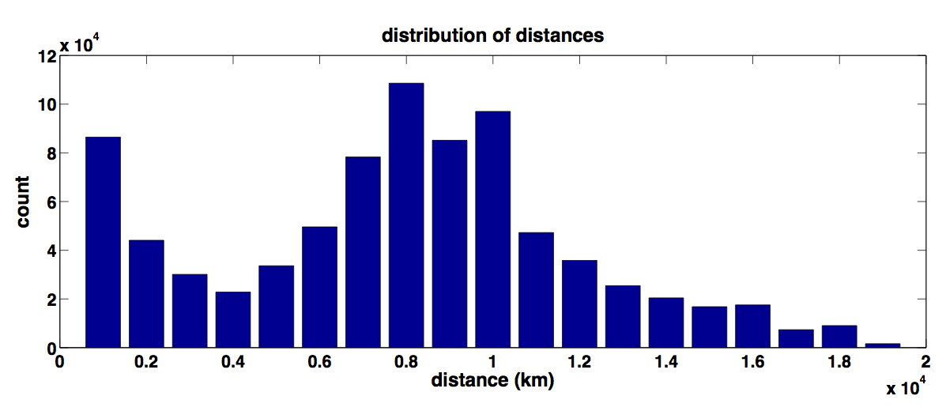
Turbo King – Distance Distribution
Notes:
Slide #2: Motivate your project by describing why its solution is important. Who would care if you are successful and why?

Slide 9
Turbo King (Modified)
Resolve:
qid.myAddr.mydomain.com
Resolve:
qid.myAddr.mydomain.com
myAddr
1
ns.target1.com
(target 1)
ns.target2.com
(target 2)
DNS Client
6
8
NXDomain
Referral:
ns.target2.com
DNS Server
5
NXDomain
4
7
Resolve:
qid.myAddr.mydomain.com
2
Resolve:
qid.myAddr.mydomain.com
ns.mydomain.com
Referral:
myAddr
5
8
Record time delta T between and
Determine RTT between myAddr and target1
Latency target1 to target2 = T – RTT
3
Notes:
Slide #2: Motivate your project by describing why its solution is important. Who would care if you are successful and why?

Slide 10
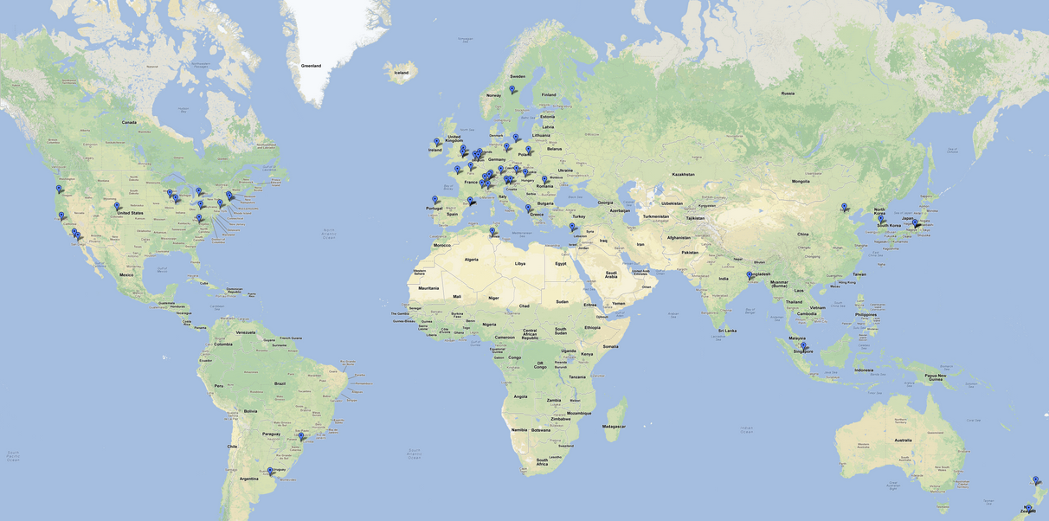
Turbo King – Planet Lab Nodes
Notes:
Slide #2: Motivate your project by describing why its solution is important. Who would care if you are successful and why?

Slide 11
Turbo King – Analysis
Distribution of Distances
Intercontinental patterns
Filter
Measurements faster than speed of light (~90,000)
Negative Latency (~41,000)
Incorrect Geo IP
Extremely High Latencies (~240,000)
5 second timeout
Results returned by forwarders (~1,140,000)
Zero Distance (~22,000)
First Result of DNS Query to new server (~2,400,000)
Extra latency introduced by DNS resolution of our domain
Reduce 4.95 Million to 1 Million
DNS Forwarders
Large Impact on Results
Nearly 25% of all queries returned by forwarders
Notes:
Slide #2: Motivate your project by describing why its solution is important. Who would care if you are successful and why?

Slide 12
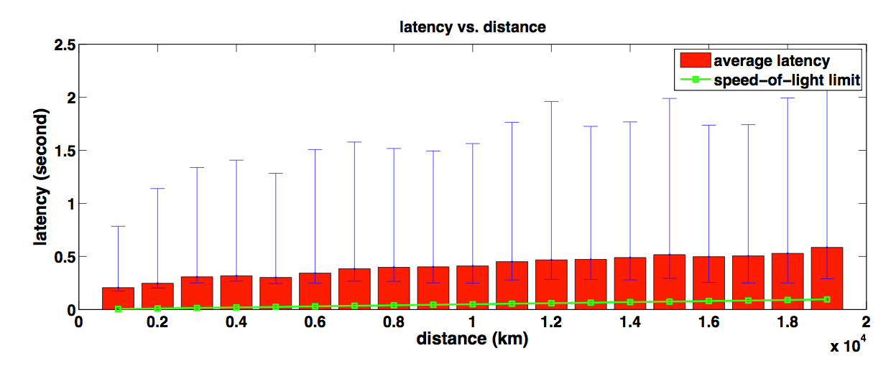
Turbo King – Latency vs. Distance
Notes:
Slide #2: Motivate your project by describing why its solution is important. Who would care if you are successful and why?

Slide 13
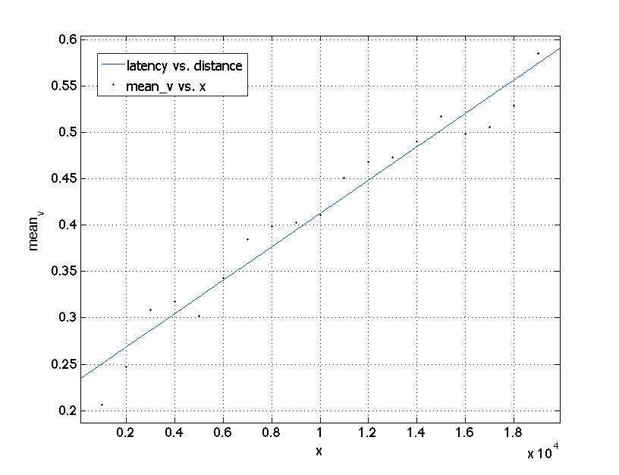
Turbo King – Latency vs. Distance
f(x) = p1*x + p2
Coefficients (with 95% confidence bounds):
p1 = 1.798e-05 (1.604e-05, 1.992e-05)
p2 = 0.2326 (0.2104, 0.2547)
Goodness of fit:
SSE: 0.008216
R-square: 0.9573
Adjusted R-square: 0.9548
RMSE: 0.02198
Notes:
Slide #2: Motivate your project by describing why its solution is important. Who would care if you are successful and why?

Slide 14
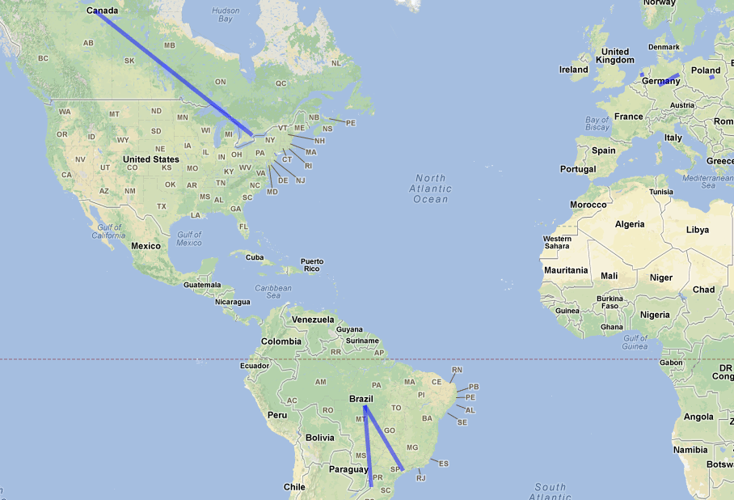
Turbo King – DNS Forwarders
Notes:
Slide #2: Motivate your project by describing why its solution is important. Who would care if you are successful and why?

Slide 15
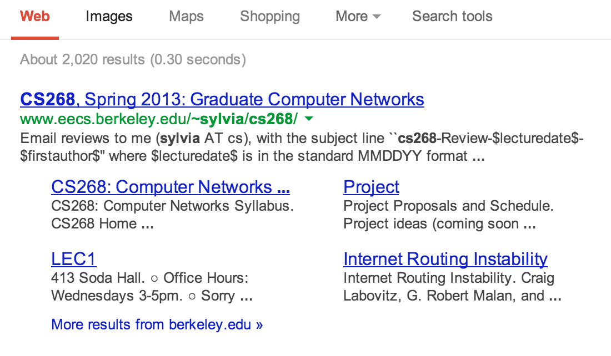
Data Center
Recap Strategies – Query Google
Query the hottest trend of that hour
Query Random Strings
Ping responded Google IP
tcpdump to parse the packet
From 19 PlanetLab nodes
'Richie Havens ’
'jthYj3KCeqbZAja9Pl2FUOMQIE8K7zZI ’
'Katherine Russell Tsarnaev ’
'pOGwlAa14a8HWaLCyyTpPWB6pd713ITG ’
'CISPA ’
'OYYWPFn0DJg2jdr3lr99LL2jwPG8W1Lq ’
'After Earth ’
'eo0kuaGsHnKxssZFGlivLNMh18RMddTL ’
…
Four different “time”:
hot-trend query time
random query time
ping time
google time
Notes:
RFC 1918
172.16.0.0 - 172.31.255.255 (172.16/12 prefix)

Slide 16
Data Center
Notes:
Random query doesn’t have google time!

Slide 17
[AS0] 172.20.10.1
~0.7 ms
Mobile Networks
[AS16509] 172.26.236.2
~35 ms
[AS16509] 172.26.241.133
~35 ms
Recap Strategies – Traceroute
from 1 AT&T iPhone (tethering)
to ~1000 top websites
at various time (2013/04/12-2013/04/24)
What we expect:
Latency on each hop
Routing stability within AT&T cellular backbone
[AS0] 172.26.96.10/172.26.96.11
172.26.96.3/172.26.96.2
~35 ms
[AS0] 172.26.96.193
~35 ms
[AS0] 172.16.121.113
~35 ms
[AS7018] 12.249.2.49
~40ms
[AS7018] 12.83.180.82
~50ms
[AS7018]
12.122.200.9/12.122.114.5
12.122.1.118/12.122.8.79…
50ms -
100 ms
[AS7018]
12.122.114.21/12.123.30.5
[AS0]
192.205.33.46/…
50 ms -
100 ms
Possibly Internet…. 50 ms – 200 ms
Notes:
RFC 1918
172.16.0.0 - 172.31.255.255 (172.16/12 prefix)

Slide 18
Mobile Networks (latency)
Notes:
RFC 1918
172.16.0.0 - 172.31.255.255 (172.16/12 prefix)

Slide 19
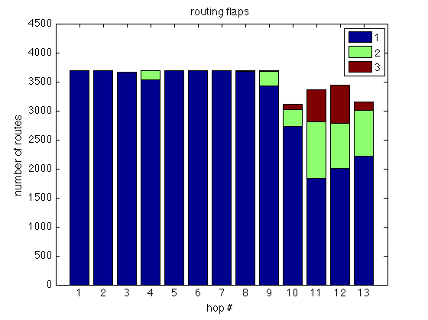
Mobile Networks (route flaps)
Notes:
RFC 1918
172.16.0.0 - 172.31.255.255 (172.16/12 prefix)

Slide 20
Mobile Networks (“mobile”)
Notes:
RFC 1918
172.16.0.0 - 172.31.255.255 (172.16/12 prefix)

Slide 21
Mobile Networks (exit point)
% traceroute -a reference.com
traceroute to reference.com (66.235.120.211), 64 hops max, 52 byte packets
1 [AS0] 172.20.10.1 (172.20.10.1) 0.927 ms 0.642 ms 0.477 ms
2 [AS16509] 172.26.242.133 (172.26.242.133) 36.689 ms 30.317 ms 35.074 ms
3 [AS16509] 172.26.236.2 (172.26.236.2) 25.838 ms 29.971 ms 31.606 ms
4 [AS0] 172.26.96.2 (172.26.96.2) 28.391 ms 27.886 ms 29.280 ms
5 [AS0] 172.26.96.193 (172.26.96.193) 30.280 ms 49.540 ms 28.846 ms
6 [AS0] 172.16.120.50 (172.16.120.50) 35.119 ms 31.004 ms 32.317 ms
7 [AS7018] 12.249.2.53 (12.249.2.53) 26.373 ms 34.862 ms 32.519 ms
8 [AS7018] 12.83.180.94 (12.83.180.94) 103.892 ms 107.387 ms 113.005 ms
9 [AS7018] cr1.sffca.ip.att.net (12.122.3.69) 106.870 ms 95.033 ms 104.060 ms
10 [AS7018] cr1.cgcil.ip.att.net (12.122.4.122) 109.386 ms 106.220 ms 108.469 ms
11 [AS7018] cr2.wswdc.ip.att.net (12.122.18.22) 100.918 ms 102.278 ms 103.591 ms
12 [AS7018] 12.123.10.137 (12.123.10.137) 97.787 ms 104.401 ms 102.540 ms
13 * * *
14 [AS10913] border10.pc1-bbnet1.wdc002.pnap.net (216.52.127.9) 197.034 ms
[AS10913] border10.pc2-bbnet2.wdc002.pnap.net (216.52.127.73) 106.194 ms 105.049 ms
15 * * *

Slide 22
Questions & Feedback?
Thank you!

